Slide 1
Prophesy Fulfilled
Times and Timing
https://youtu.be/VnWcHiBMBYs

Slide 2
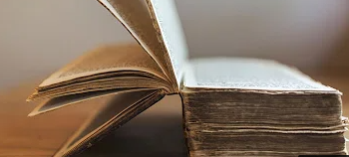
True Preparation
Unexpected response to last Presentation
  Thank you for watching and sharing the previous presentation of my observations from watching. Over 108,000 views, WOW!
  Calls from Netherlands, England, Australia—watchers everywhere. Some seasoned watchers, some new:
  Brother Goddard, I came across an online devotional that you gave on the subject of the second coming of Jesus Christ. I stumbled across it on youtube and listened to it just yesterday. I was completely blown away. I have been a member of the church my whole life but feel like I have been asleep! I had no idea any of these signs were occurring. I am one that has not been watching. Thank you for sharing this message. I have been inspired to make this a topic of serious study as I consider many of the things you have shared.
Wonderful! This is my hope and purpose in sharing my presentations.

Slide 3

Commanded to Watch
  Luke 21:36 Watch ye therefore, and pray always (and keep my commandments), that ye may be accounted worthy to escape all these things that shall come to pass, and to stand before the Son of man (when He shall come clothed in the glory of His Father).
  I present scriptures, quotes from prophets and my observations. I have not received dreams or revelations and do not represent the Church of Jesus Christ of Latter-Day Saints.
Sign up with your email for a copy of slides.

Slide 4

Watcher Cycle
Preparation Progression (my perception)
  Phase One: Curiosity because of friends, messages, video, conference, etc.
    Person begins to study and investigate.
  Phase Two: Acceptance and PANIC!
    Focus on physical preparation. Need stuff!! (obedience)
  Phase Three: Overwhelmed and worried
    What about my children, friends, ward members? Can’t do or even think of everything. (sacrifice)
  Phase Four: The Lord’s perspective and peace (consecration)
    Spiritual preparation in faith, trusting God, joy for the Savior’s coming
Question: Are you a better person, a more spiritual soul, a more devoted disciple, a more Christ-like child of God, since starting your path in preparedness?

Slide 5

Times and Timing
How is this presentation different from the last one?
  Focus on timing from the scriptures, etc.
  Review and update of last presentation
  Correction from last presentation
  Review different perspectives in
  interpreting the prophesies
Important point: If you expect me to tell you a definitive time for the second coming or the events preceding His coming…you will be disappointed.

Slide 6

Christ’s Prophesy of Second Coming
  The disciples asked the Lord when he would come again (5 versions)
  Matthew 24 … the sign of thy coming and of the end of the world?
  PGP: JS Matthew…the sign of thy coming, and of the end of the world…?
  Mark 13 …Peter and James and John and Andrew …Tell us, when shall these things be? And what shall be the sign when all these things shall be fulfilled?
  Luke 21 …Master, but when shall these things be? And what sign…
  D&C 45 …As ye have asked of me concerning the signs of my coming, in the day when I shall come in my glory…
  All sources:
  Signs and trials, parable of the fig tree,
  commandment to WATCH.
  Watch for what?

Slide 7
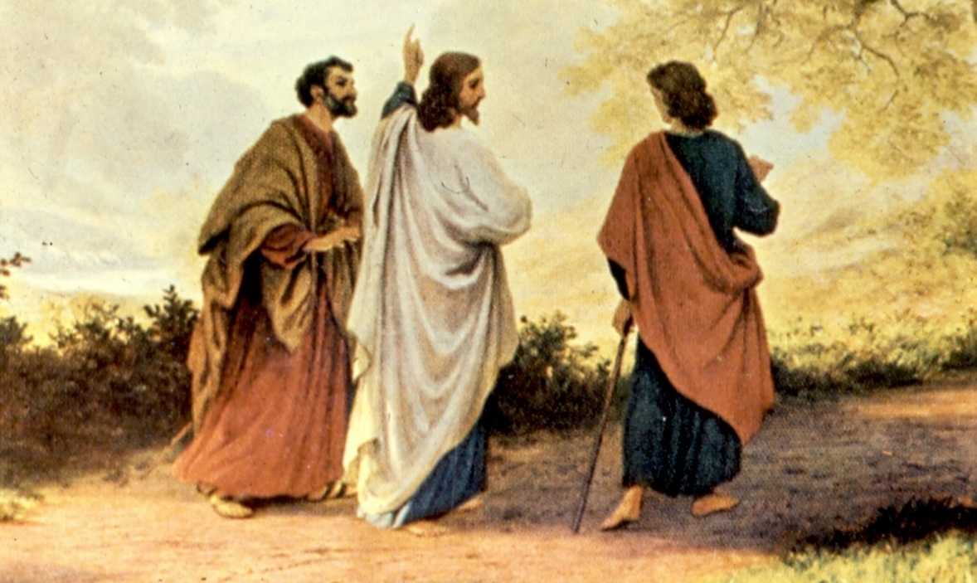
Second Coming Warnings
  After the signs for the temple’s destruction, which were all fulfilled, Christ gave the signs of His second coming:
  Luke 21:24-27 JST: Now these things he spake unto them, concerning the destruction of Jerusalem. And then his disciples asked him, saying, Master, tell us concerning thy coming? And he answered them, and said,
  In the generation in which the times of
  the Gentiles shall be fulfilled,)
  there shall be… (signs described)

Slide 8
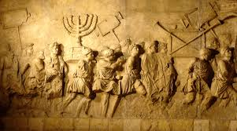
Time of the Gentiles
  Christ says “of that day and that hour knoweth no man” but immediately and repeatedly refers to the generation that will witness His coming
  Luke 21:32 Verily I say unto you, this generation, (JST: the generation when the times of the Gentiles be fulfilled), shall not pass away, till all be fulfilled. Heaven and earth shall pass away: but my words shall not pass away.
  When is the time of the Gentiles fulfilled?

Slide 9
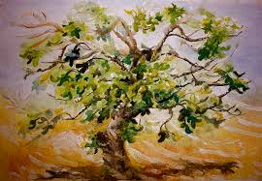
The Parable of the Fig Tree
  Matt 24:32-34 Now learn a parable of the fig tree; when its branch is yet tender, and puts forth leaves, you know that summer is near: So likewise you, when you shall see all these things, know that it is near, even at the doors. Verily I say unto you, this generation shall not pass away, til all these things be fulfilled.
  Fig tree represent Israel
  When you shall see all Israel blossom,
  fulfillment is within a generation
Jews in Israel
1930 174,610
1947 630,000
1970 2,582,000
1980 3,282,705
2020 6,806,000
Jews in Israel
1930 174,610
1947 630,000
1970 2,582,000
1980 3,282,705
2020 6,806,000

Slide 10
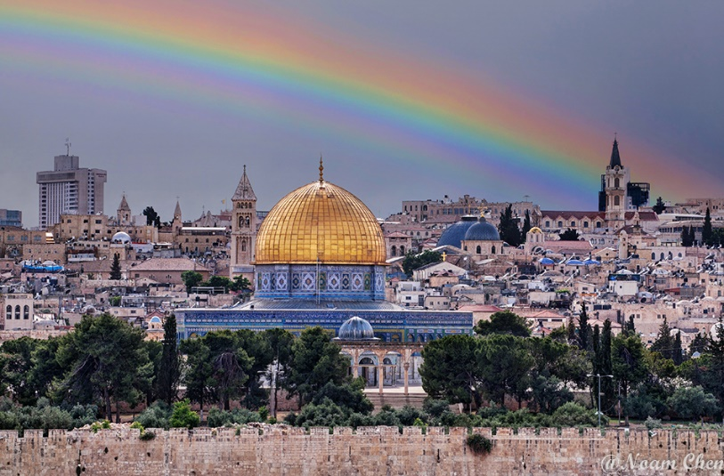
Time of the Gentiles-Fulfilled
  Luke 21: 24 …until the times of the Gentiles be fulfilled.
  Orson Pratt: “That the times of the Gentiles are not yet fulfilled is proven by the fact that Jerusalem is still in possession of the Gentiles, and under their control…hundreds of thousands of the twelve tribes will return to Palestine,
  and their capital city will be Jerusalem, not Samaria.”
  (JD 16:342)
  Parley P. Pratt “Jerusalem shall be trodden down of the Gentiles until the times of the Gentiles be fulfilled…The people who
  shall live when the times of the Gentiles are fulfilled…
  the generation that will be alive when Jerusalem and
  the Jews are about to be restored …“Then shall they see
  …The Son of man coming in a cloud with power and
  great glory.” (JD 3:132)

Slide 11
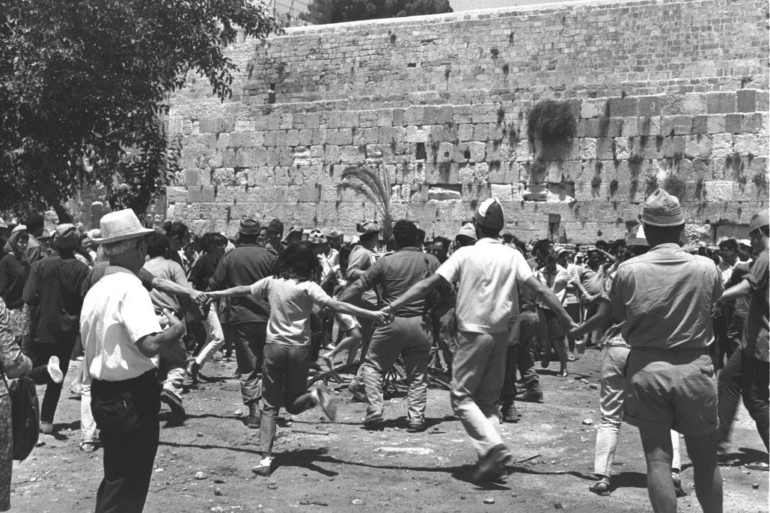
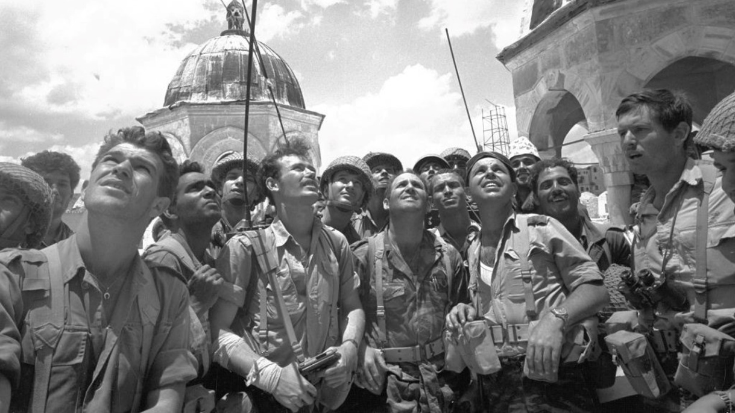
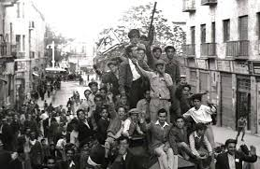
Time of the Gentiles-Fulfilled
  Luke 21: 24 And Jerusalem shall be trodden down of the Gentiles, until the times of the Gentiles be fulfilled.
  Gentiles populated Israel until 1947, Jerusalem until 1967 when the Jews returned. So, if the times of the gentiles was fulfilled, that generation will not pass away until all is fulfilled.

Slide 12

Generations
Is the prophesied generation alive today?
Pres. Benson reviewed the same prophesies of Christ and then declared: “Youth of Zion, do you realize you are living in the days of the fulfillment of these signs and wonders? You are among those who will see many of these prophecies fulfilled. Just as certain as was the destruction of the temple at Jerusalem and the scattering of the Jews, so shall these words of the Savior be certain to your generation.”
(1982 BYU Devotional, May New Era– Prepare Yourself for the Great Day of the Lord)
  What is the significance of generations?
    Prophesies and powers, judgment and retribution,
    promises and blessings

Slide 13
Signs Summary
2000
2002
2004
2006
2008
2010
2012
2014
2016
2018
2020
2022
2024
2026
2028
2030
2032
1967 Generation of “Time of Gentiles Fulfilled” (70 years per generation-Psalms 90:10)
Gospels

Slide 14

Surely our Prophets would warn us!
Pres. Benson: Knowing what we know as His servants, can we hesitate to raise a warning voice to all who will listen that they may be prepared for the days ahead? Silence in the face of such calamity is sin! (Prepare Yourself for the Great Day of the Lord.)
What about our living Prophet and Apostles?

Slide 15
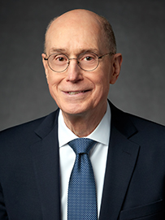
October 2020 Conference Messages
Elder Eyring: Sisters in Zion
“I am blessed to speak during this wonderful time in the world’s history. Every day, we are approaching closer to the glorious moment when the Savior Jesus Christ will come to earth again. We know something of the terrible events that will precede His coming, yet our hearts swell with joy and confidence also knowing of the glorious promises that will be fulfilled before He returns…you will play a crucial part in the grand times ahead. We know that the Savior will come to a people who have been gathered and prepared to live as the people did in the city of Enoch.”

Slide 16
October 2020 Conference Messages
Elder Eyring: Sisters in Zion
“…to gather out my elect from the four quarters of the earth, unto a place which I shall prepare…Zion, a New Jerusalem. You sisters…will be at the heart of creating that society of people who will join in glorious association with the Savior. You will be an essential force in the gathering of Israel and in the creation of a Zion people who will dwell in peace in the New Jerusalem.”

Slide 17
October 2020 Conference Messages
Elder Eyring: Tested, Proved, and Polished
“As you live worthy of the gift of the Holy Ghost, the Lord can direct you to safety even when you cannot see the way. (Referred to Joseph in Liberty Jail)

Slide 18
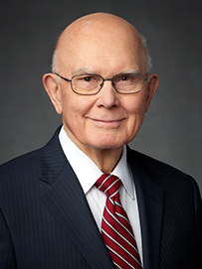
October 2020 Conference Messages
Elder Oaks: Love Your Enemies
“The Constitution and laws contain no invitation to revolution or anarchy.”
Elder Oaks: Be of Good Cheer
“…we often give thanks that our physical challenges—apart from earthquakes, fires, floods, and hurricanes—
are usually less than our predecessors faced. “ (Referred to Joseph in Liberty jail.)

Slide 19
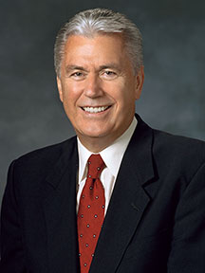
October 2020 Conference Messages
Elder Uchtdorf: God Will Do Something Unimaginable He told how building of SL Temple was interrupted but led to the discovery and repair of flaws in the foundation. “This story can teach us how God uses adversity to bring about His purposes…I doubt there is a person who hears my voice or reads my words who has not been affected by the worldwide pandemic…this virus did not catch Heavenly Father by surprise…God has prepared His children and His Church for this time…the righteous are not given a free pass…things might get worse before they get better…with Christ at the helm, things will not only be all right; they will be unimaginable. (Referred to Joseph in Liberty Jail.)

Slide 20
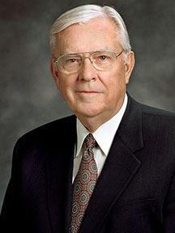
October 2020 Conference Messages
Elder Ballard: Watch Ye Therefore, and Pray Always
“Among the “things that shall come to pass” before His Second Coming are “wars and rumours of wars [,} …famines, and pestilences, and earthquakes, in divers places.” In the Doctrine and Covenants, the Savior said, “And all things shall be in commotion; … for fear shall come upon all people.” Certainly, we live in a time during which things are in commotion.” Description of violence, moral denigration, pandemic, economic upheaval, riots, conflict. “…we stand today at a major crossroads in history, and the nations of the earth are in desperate need of divine inspiration and guidance…Humbling ourselves and seeking heaven’s inspiration to endure or conquer what is before us will be our safest and surest way to move confidently forward through these troubling times.”

Slide 21
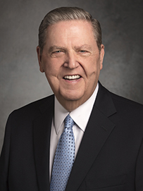
October 2020 Conference Messages
Elder Holland: Waiting on the Lord
“The point is that faith means trusting God in good times and bad, even if that includes some suffering until we see His arm revealed in our behalf…Christianity is comforting, but it is often not comfortable. .” (Refers to Joseph in Liberty Jail)

Slide 22
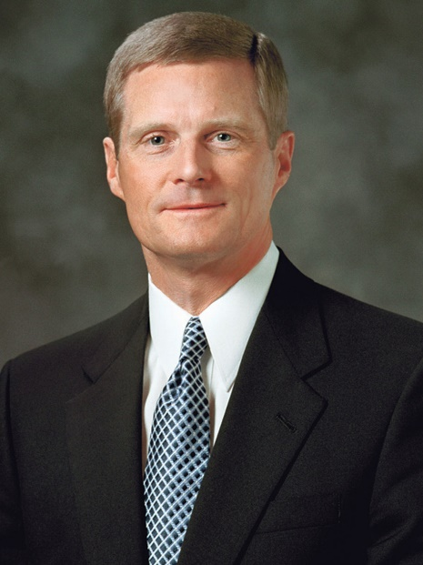
October 2020 Conference Messages
Elder Bednar: We Will Prove Them Herewith
“Some Church members opine that emergency plans and supplies, food storage, and 72-hour kits must not be important anymore because the Brethren have not spoken recently and extensively about these and related topics in general conference. But repeated admonitions to prepare have been proclaimed by leaders of the Church for decades. The consistency of prophetic counsel over time creates a powerful concert of clarity and a warning volume far louder than solo performances can ever produce…We learn for example, in the parable of the ten virgins that procrastinating preparation leads to unsuccessful proving…Now is the time to prepare and prove ourselves willing and able to do all things whatsoever the Lord our God shall command us.”

Slide 23
October 2020 Conference Messages
Elder Bednar: We Will Prove Them Herewith
“As we “press forward with a steadfastness in Christ, having a perfect brightness of hope, and a love of God and of all men,” we are blessed with an eternal perspective and vision that stretches far beyond our limited mortal capacity. We will be enabled to “gather together, and stand in holy places” and “be not moved, until the day of the Lord come.”

Slide 24
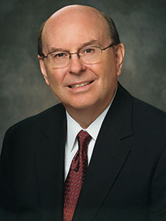
October 2020 Conference Messages
Elder Cook: Hearts Knit in Righteousness and Unity
“It has been 200 years since the Father and His Son first appeared and commenced the Restoration of the gospel of Jesus Christ in 1820. The account in 4 Nephi in the Book of Mormon includes a similar 200-year period after the Savior appeared and established His Church in ancient America…Unfortunately, 4 Nephi then describes a dramatic change that began in the “two hundred and first year,” when iniquity and division destroyed righteousness and unity…At this 200-year hinge point in our Church history, let us commit ourselves as members of the Lord’s Church to live righteously and be united as never before.”

Slide 25
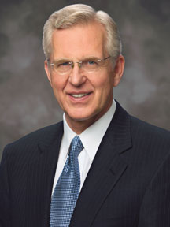
October 2020 Conference Messages
Elder Christofferson: Sustainable Societies
“…Unfortunately,…the ideal society described in 4 Nephi of the Book of Mormon did not endure beyond its second century. Sustainability is not guaranteed, and a thriving society can fail in time if it abandons the cardinal virtues that uphold its peace and prosperity…When one has no higher god than himself and seeks no greater good than satisfying his own appetites and preferences, the effects will be manifest in due course.”

Slide 26
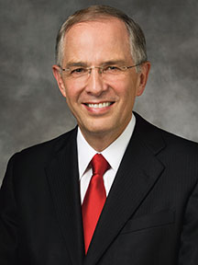
October 2020 Conference Messages
Elder Anderson: We Talk of Christ
“A recent study revealed that in the last 10 years, 30 million
people in the United States have stepped away from
believing in the divinity of Jesus Christ. Looking worldwide,
another study predicts that in the decades ahead, more than
twice as many will leave Christianity as will embrace it…
I witness that the day will come when every knew will bow
and every tongue confess that Jesus is the Christ…everything
in our worship should point to the Lord Jesus Christ…In the days ahead,
those who believe in Jesus Christ will need the friendship and support of one another…Nothing lifts my desire to speak of Christ more than visualizing His return. While we do not know when He will come, the events of His return will be breathtaking!...Can you imagine being caught up to meet Him, whether on this side or the other side of the veil? That is His promise to the righteous. This amazing experience will mark our souls forever.”

Slide 27
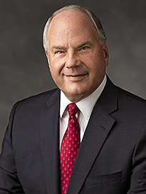
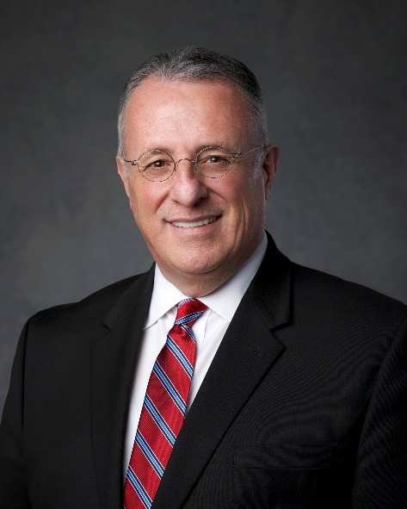
October 2020 Conference Messages
Elder Rasband: Recommended to the Lord
“Let me emphasize, whether you have access to a temple or not, you need a current temple recommend to stay firmly on the covenant path.”
Elder Soares: Seek Christ in Every Thought
  “In his historic and touching message from April this year, our dear prophet, President Russell M. Nelson, made a promise that all those who are willing to “hear Him”—hear Jesus Christ—and obey His commandments “will be blessed with additional power to deal with temptations, struggles, and weakness” and that our capacity to feel joy will increase, even during the increasing current turbulence. (Refers to Joseph in Liberty Jail)

Slide 28
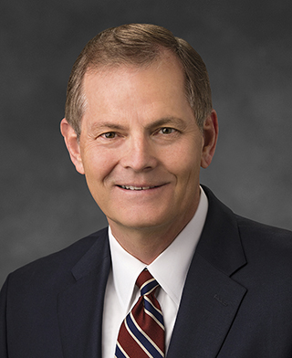
October 2020 Conference Messages
Elder Stevenson: Highly Favored of the Lord
“…’A home-centered Church, supported by what takes place inside our…buildings.’ What a prophetic adjustment!...I believe that in this life, and in the life to come, your afflictions, your Ammonihah, your Liberty Jail, will be consecrated for your gain.” (Referred to Joseph in Liberty Jail)

Slide 29
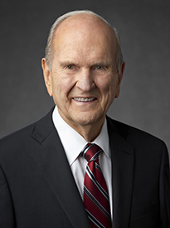
October 2020 Conference Messages
President Nelson: Embrace the Future with Faith
“Admittedly, the Lord has spoken of our day in sobering terms. He warned that in our day “men’s hearts [would fail] them” and that even the very elect would be at risk of being deceived. He told the Prophet Joseph Smith that “peace [would] be taken from the earth” and calamities would befall mankind.
Yet the Lord has also provided a vision of how remarkable this dispensation is. He inspired the prophet Joseph Smith to declare that “the work of … these last days, is one of vast magnitude. … Its glories are past description, and its grandeur unsurpassable.”
Now, grandeur may not be the word you would choose to describe these past few months! How are we to deal with both the somber prophecies and the glorious pronouncements about our day? The Lord told us how with simple, but stunning, reassurance: “If ye are prepared ye shall not fear.”

Slide 30
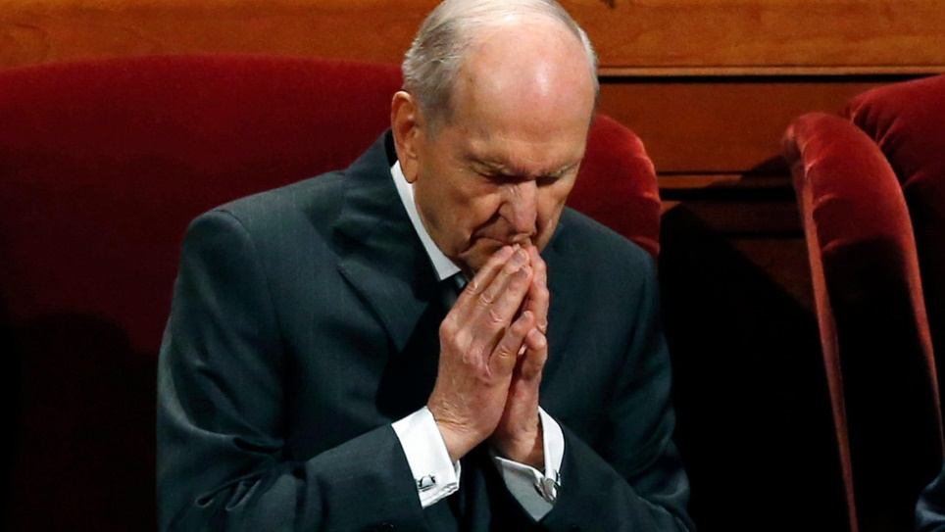
October 2020 Conference Messages
President Nelson: Embrace the Future with Faith
“If preparation is our key to embracing this dispensation and our future with faith, how can we best prepare?
For decades, the Lord’s prophets have urged us to store food, water, and financial reserves for a time of need. The current pandemic has reinforced the wisdom of that counsel. I urge you to take steps to be temporally prepared. But I am even more concerned about your spiritual and emotional preparation…Moroni prepared his people in three essential ways. First, he helped them create areas
where they would be safe—”places of security” he called
them. Second, he prepared “the minds of the people to be
faithful unto the Lord.” And third, he never stopped
preparing his people—physically or spiritually.”

Slide 31
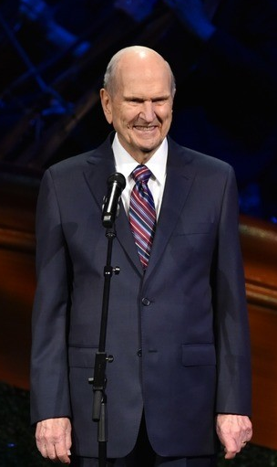
October 2020 Conference Messages
President Nelson: Embrace the Future with Faith
“The Lord has promised that if we will ask, we may receive ‘revelation upon revelation.’ I promise that as you increase your capacity to receive revelation, the Lord will bless you with increased direction for your life and with boundless gifts of the Spirit”
“The adversary never stops attacking. So, we can never stop preparing! The more self-reliant we are—temporally, emotionally, and spiritually—the more prepared we are to thwart Satan’s relentless assaults…The Lord placed you here now because He knew you had the capacity to negotiate the complexities of the latter part of these latter days…I am not saying that the days ahead will be easy, but I promise you that the future will be glorious for those who are prepared and who continue to prepare to be instruments in the Lord’s hands.”

Slide 32
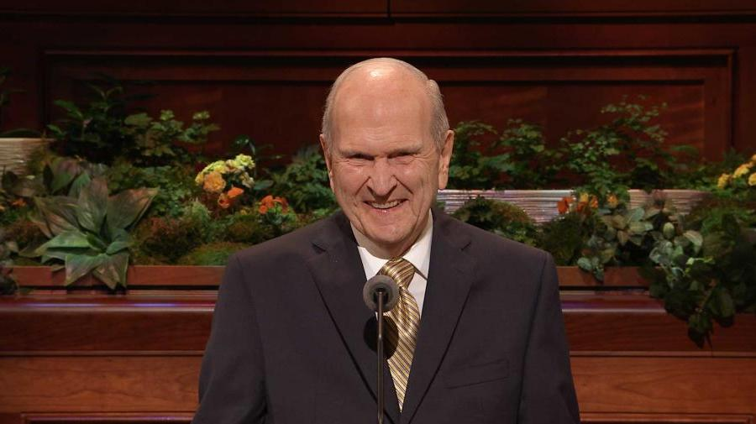
October 2020 Conference Messages
President Nelson: Embrace the Future with Faith
“My dear sisters, let us not just endure this current season. Let us embrace the future with faith! Turbulent times are opportunities for us to thrive spiritually. They are times when
our influence can be much more
penetrating than in calmer times.”

Slide 33
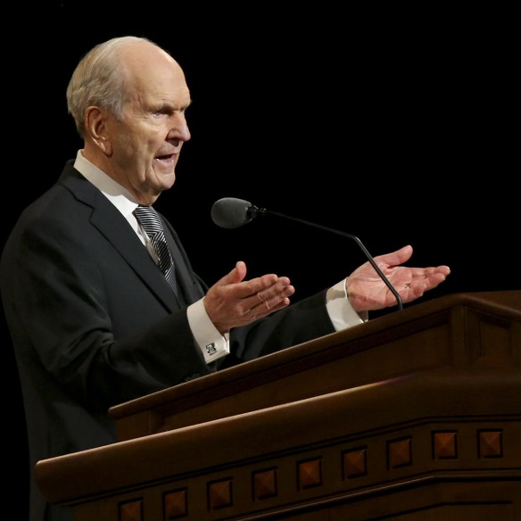
October 2020 Conference Messages
President Nelson: Let God Prevail
“For the more than 36 years I’ve been an Apostle, the doctrine of the gathering of Israel has captured my attention…and the numerous prophecies about the gathering in our day…For centuries prophets have foretold this gathering, and it is happening right now! As an essential prelude to the Second Coming of the Lord, it is the most important work in the world!...Are you willing to have your will swallowed up in His? During these perilous times of which
the Apostle Paul Prophesied, (2 Timothy 3:1-13) Satan is no
longer even trying to hide his attacks on God’s plan.
Emboldened evil abounds. Therefore, the only way to
survive spiritually is to be determined to let God prevail
in our lives, to learn to hear His voice, and to use our
energy to help gather Israel.”

Slide 34
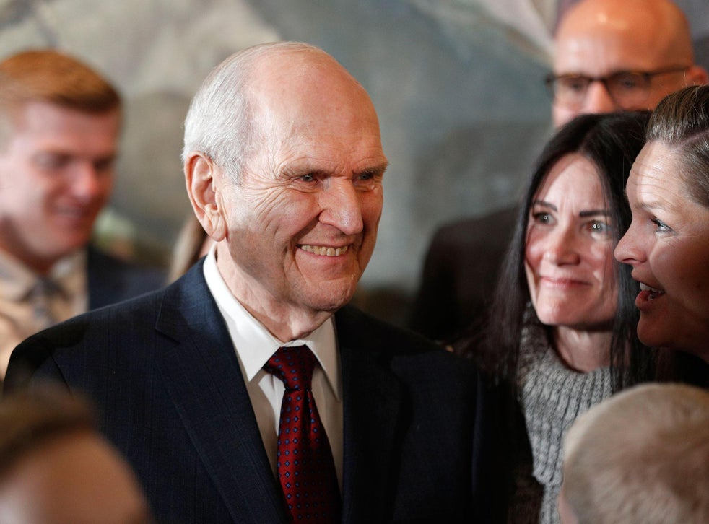
October 2020 Conference Messages
President Nelson: A New Normal
“We live in a glorious age, foreseen by prophets for centuries. This is the dispensation when no spiritual blessing will be withheld from the righteous. Despite the world’s commotion (D&C 45, 88), the Lord would have us look forward to the future ‘with joyful anticipation.’…live each day so that
you are more prepared to meet your
Maker… May we go forward together
to fulfill our divine mandate—that of
preparing ourselves and the world for
the Second Coming of the Lord.”

Slide 35
President Nelson, Our Prophet
“Just think of the excitement and urgency of it all: every prophet
commencing with Adam has seen our day. And every prophet has
talked about our day, when Israel would be gathered and the world
would be prepared for the Second Coming of the Savior. Think of it!
Of all the people who have ever lived on planet earth, we are the ones
who get to participate in this final, great gathering event. How
exciting is that! Our Heavenly Father has reserved many of His most
noble spirits﻿—perhaps, I might say, His finest team﻿—for this final
phase. Those noble spirits﻿—those finest players, those heroes﻿—
are you!” (Hope of Israel, Worldwide Youth Devotional, June 3, 2018)
“Our Savior and Redeemer, Jesus Christ, will perform some of His mightiest works between now and when He comes again. We will see miraculous indications that God the Father and His Son, Jesus Christ, preside over this Church in majesty and glory,” (“Revelation for the Church, Revelation for Our Lives,“ Apr. 2018 general conference).
“Do the spiritual work to find out for yourselves, and please do it now. Time is running out.” (Come Follow Me, April 2019 GC)

Slide 36
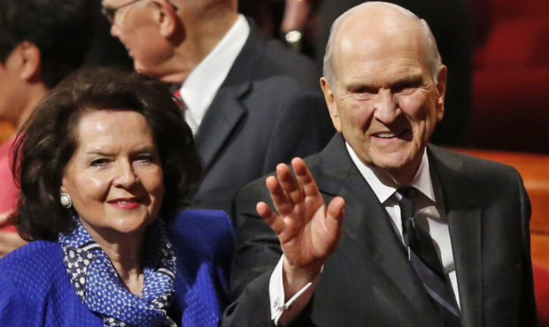
President Nelson, Our Prophet
“We are just building up to the
climax of this last dispensation—
when the Savior’s Second Coming
becomes a reality.” The Future of the Church,
Preparing the World for the Savior’s Second Coming, April 2020, 200 Years of Light: 1820-2020
“But perhaps these days are more “latter” than we have ever imagined.” Sister Nelson, Hope of Israel, Worldwide Youth Devotional, June 3, 2018
Are members of the church preparing? What percent believe its soon and are actively preparing?

Slide 37
Signs Summary
2000
2002
2004
2006
2008
2010
2012
2014
2016
2018
2020
2022
2024
2026
2028
2030
2032
Prophetic warnings
1967 Generation of “Time of Gentiles Fulfilled” (70 years per generation-Psalms 90:10)
Gospels

Slide 38
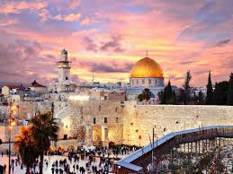
Why Now?
  Broken Covenants
    Abrahamic Covenant
Abrahamic Blessings given:
Promised land, prosperity, posterity, protection
Abrahamic Blessings taken:
Shemita 2001: Protection—9/11 (Isaiah 9, The Harbinger)
Shemita 2008: Prosperity—Financial crash
Shemita 2015: Posterity—Redefined family
Shemita 2022: Promised land—war?

Slide 39
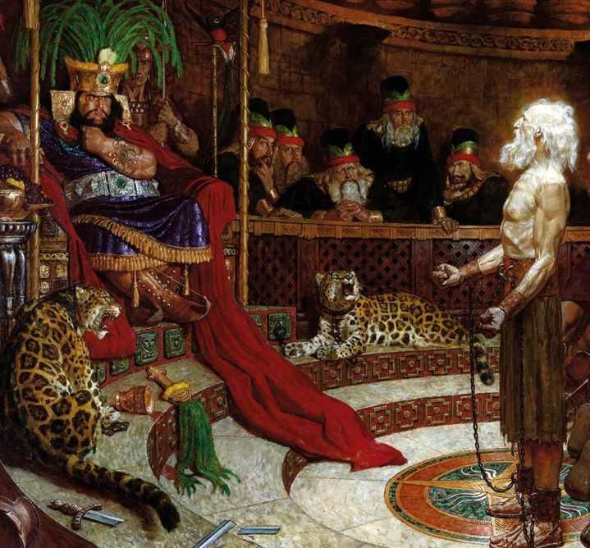
Why Now?
  Broken Covenants—Nephite Covenant
    And he said: Thus saith the Lord God—Cursed shall be the land, yea, this land, unto every nation, kindred, tongue, and people, unto destruction, which do wickedly, when they are fully ripe. Alma 45:16

Slide 40
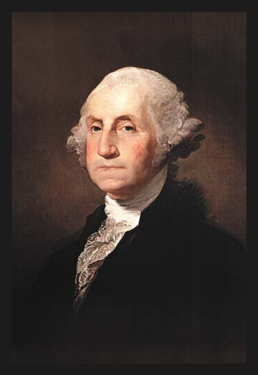
Why Now?
  Broken Covenants—American
    George Washington Inauguration: “No People can be bound to acknowledge and adore the invisible hand, which conducts the Affairs of men more than the People of the United States. Every step, by which they have advanced to the character of an independent nation, seems to have been distinguished by some token of providential agency…Since we ought to be no less persuaded that the propitious smiles of Heaven, can never be expected on a nation that disregards the eternal rules of order and right, which Heaven itself has ordained”

Slide 41
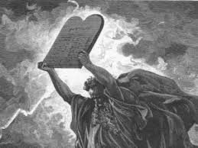
Why Now?
  Broken Commandments
    10 Commandments
      Mocking God
      Immorality, Porn $12 B in U.S., $100 B globally
      Breaking Sabbath
  Further, we warn that the disintegration of the family will bring upon individuals, communities and
  nations the calamities foretold by ancient and
  modern prophets. (The Family Proclamation)

Slide 42
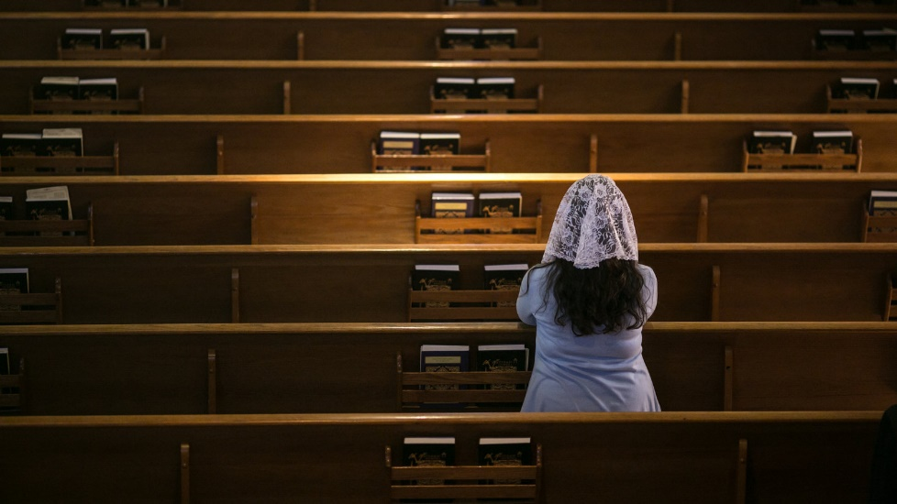
Why Now?
  Rejecting the Messiah
  Elder Anderson: We Talk of Christ
  “A recent study revealed that in the last 10 years, 30 million
  people in the United States have stepped away from
  believing in the divinity of Jesus Christ. Looking worldwide,
  another study predicts that in the decades ahead, more than
  twice as many will leave Christianity as will embrace it…

Slide 43
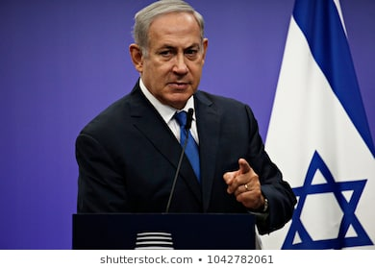
But the Timing Was Known
  Speech by Israel Prime Minister Netanyahu to the United Nations
  9/19/17 referring to the historic year 2017 - Jewish year 5777 – Jubilee Year
  (Jubilee Year = Year following 7 Shemitas {Sabbath Years} of 7 years)
  120 years ago (1897): first Zionist conference organized by Theodore Herzel-Modern Moses
  100 years ago (1917): Balfour declaration giving Jews the right to a national homeland. (Jubilee).
  70 years ago (1947): U.N. declared the rights of the Jews to a national homeland
  50 years ago (1967): Jews returned to Jerusalem (Jubilee)
  Was 2017 significant? Take note in the following slides.

Slide 44
Signs Summary
2017/5777
2000
2002
2004
2006
2008
2010
2012
2014
2016
2018
2020
2022
2024
2026
2028
2030
2032
Prophetic warnings
1967 Generation of “Time of Gentiles Fulfilled” (70 years per generation-Psalms 90:10)
Gospels
Wickedness and Broken Covenants 2017 (5777) Significance:
100 years from Balfour (1917 - Jubilee), 70 years from UN (1947), 50 years from Jerusalem return (1967 – Jubilee)
9/11/01
Attack – Isaiah 9:10

Slide 45

Watch for These Signs
  Luke 21:24-27 Signs in the Generation
  …signs in the sun, and in the moon and in the stars;
  CELESTIAL SIGNS
  and upon the earth distress of nations, with perplexity;
  DISTRESS OF NATIONS
  the sea and waves roaring; (The earth also shall be troubled, and the waters of the great deep;)
  NATURAL DISASTER
  Men’s hearts failing them for fear, and for looking after those things which are coming on the earth: for the powers of heaven shall be shaken.
  FEAR FROM EVENTS AND HEAVEN’S POWER SHAKEN
  And then shall they see the Son of man coming in a cloud with power and great glory.

Slide 46

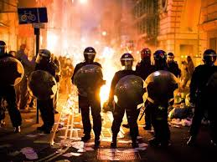
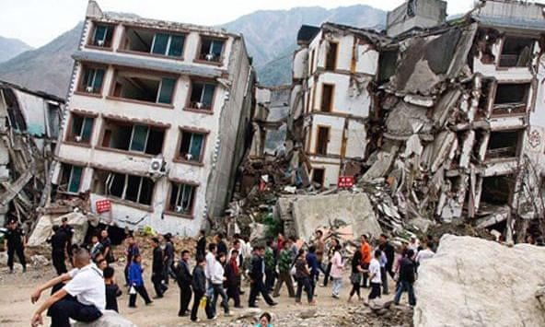

Wickedness brings the Signs of Judgment!
Celestial Signs
Distress of Nations
Christ’s
Prophesied
Signs
(Update)
Natural Disasters
Fear, Heavens Shaken

Slide 47
Celestial Signs
Sun darkened
Isaiah 13:10, Joel 2:10, 31; 3:15, Matt. 24:29, Mark 13:24, Luke 21:25, Acts 2:20, 2 Nephi 23:10, Rev. 6:12, 8:12, D&C 29:14, 34:9, 45:42, 133:49
Moon turned to blood (darkened)
Isaiah 13:10, 24:23, Ezekiel 32:7-8, Joel 2:10, 31, 3:15, Matt. 24:29, Mark 13:24, Luke 21:25, Acts 2:20, Rev. 6:12, 2 Nephi 23:10, D&C 29:14, 34:9, 45:2, 133:49
Stars Falling
Matt. 24;29, Luke 21:25, Rev. 6:12, 8:10, 8:12, D&C 133:49

Slide 48
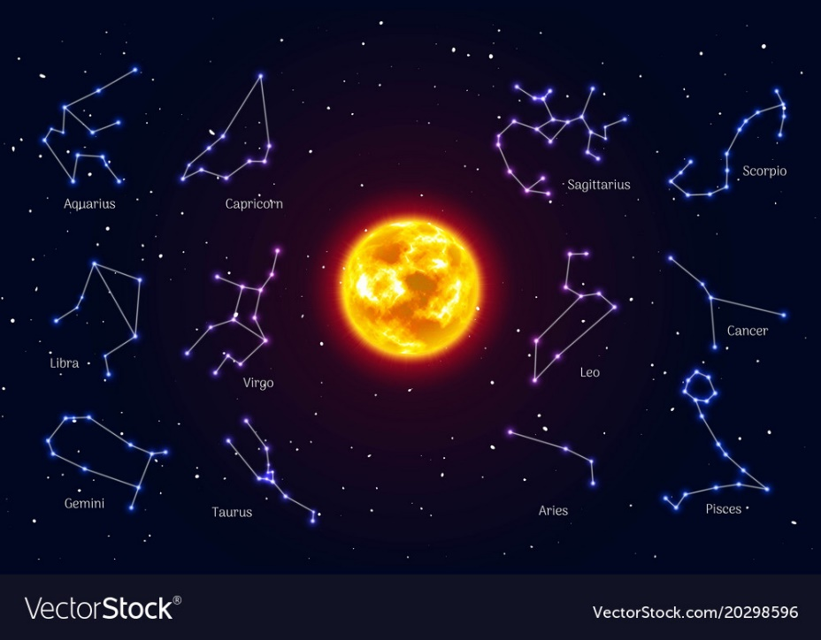
Celestial Signs
What heavenly signs should we expect?
  Matthew 16:4 The Pharisees also with the Sadducees came, and tempting desired him that he would shew them a sign from heaven. (Sign in Hebrew means constellation. Healings and raising people from the dead were not enough, the Jews believed in heavenly signs.)
  ”He answered and said unto them, When it is evening, ye say, It will be fair weather: for the sky is red. O ye hypocrites, ye can discern the face of the sky; but can ye not discern the signs of the times? A wicked and adulterous generation seeketh after a sign; and there shall no sign be given unto it, but the sign of the prophet Jonas.

Slide 49
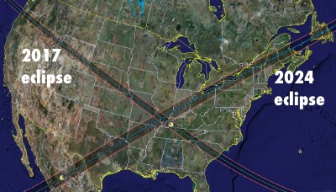
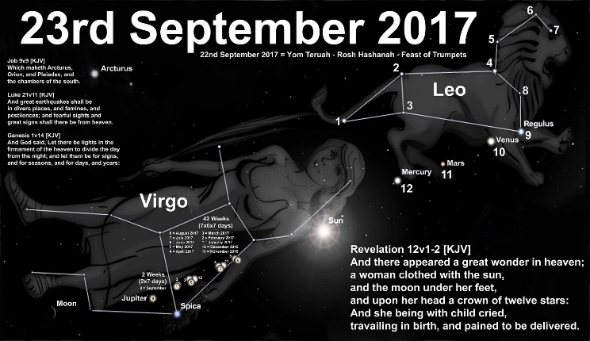
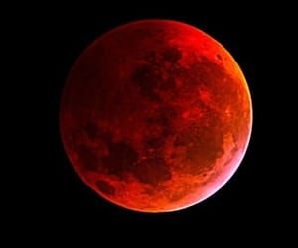

Celestial Signs Given?
Are there enough Celestial Signs to fulfill Christ’s prophesy?
  Sign of Jonas: Sign of the Times, Eclipse—2017 and 2024
  Sign of the Woman from the book of Revelation--2017
  Also the “Star of Bethlehem” reoccurrence in 2015—first time since 3-2 BC
    Conjunction of Venus, Jupiter, and Mars (Times of Israel)
  Sextet of “blood moons”—2014-15
  Dec 21, 2020—conjunction of Jupiter and Saturn.
  First since 2000, closest since 1623.
Palmyra, New York

Slide 50
Signs Summary
2017/5777
2000
2002
2004
2006
2008
2010
2012
2014
2016
2018
2020
2022
2024
2026
2028
2030
2032
1967 Generation of “Time of Gentiles Fulfilled” (70 years per generation-Psalms 90:10)
Gospels
Wickedness and Broken Covenants 2017 (5777) Significance:
100 years from Balfour (1917 - Jubilee), 70 years from UN (1947), 50 years from Jerusalem return (1967 – Jubilee)
9/11/01
Attack – Isaiah 9:10 See: The Harbinger
Eclipse
(Sign of Jonah)
7
Years
Eclipse
(Sign of the Times)
Sun
3.5
3.5
Signs in Heavens
Blood Moons
Moon
Sign of Woman
Stars
Star of Bethlehem?
Woman (Church) Protected for 1260 days (3.5 years to March 5, 2021)
Israel

Slide 51
Distress of Nations
War
Isaiah 13:15-18, Ezekial 32:11-13, Joel 2:11, Matt 24:6-7, Mark 13:8, Luke 21:10, 2 Nephi 23:15, D&C 45:63
End of Nations
D&C 87:6
Economic, Cultural, Political Turmoil

Slide 52
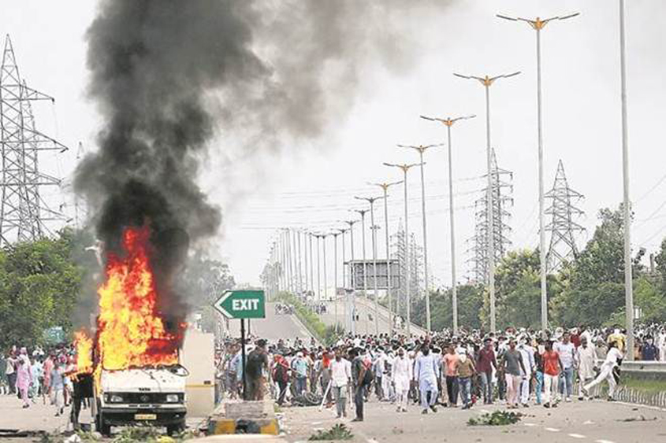
Distress: Political
Orson Pratt and Politics of the Last Days
  “It has been revealed that the time will come in the history of our nations, that one State will rise against another, one city against another, even every man’s hand shall be against his neighbor, until the whole Republic will be in general commotion and warfare…For aught we know, the fulfillment of this prophecy may grow out of politics. If the people are very
  nearly equally divided in politics, this feeling
  may run so high, in years to come, as to be the
  direct cause of war. And if this should be the case,
  it would very naturally spread to every
  neighborhood in the Union.”

Slide 53
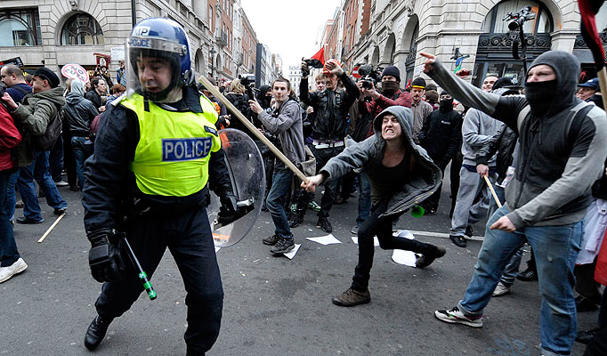
Distress: Political
Orson Pratt and Politics of the Last Days (Continued)
  “One class of political opponents would rise up against the other class in the same city and country, and thus would arise a war of mobocracy. If a war of this description should take place, who would carry on his business in safety? Who would feel safe to put his crops in the ground or to carry on any enterprise? There would be fleeing from one State to another, and general confusion would exist throughout the whole Republic. Such eventually is to be the condition of this whole nation, if the people do not repent of their
  wickedness; and such a state of affairs means no
  more or less than the complete overthrow of the
  nation, and not only of this nation, but the nations
  of Europe”
  Orson Pratt, Journal of Discourses, Vol.20 p.150-151,
  March 9, 1879

Slide 54

Distress: Race Riots
President Benson, Sept. GC 1967
  “As far back as 1928, the communists declared that the cultural, economic, and social differences between the races in America could be exploited by them to create the animosity, fear, and hatred between large segments of our people that would be necessary beginning ingredients for their revolution. Briefly, the three broad objectives were—and are—as follows:
    Create Hatred
    Trigger Violence
    Overthrow Established Government”

Slide 55

Distress: Political
President Benson
  “1. Create Hatred. Use any means to agitate blacks into hating whites and whites into hating blacks. Work both sides of the split. Play up and exaggerate real grievances. If necessary, don’t hesitate to manufacture false stories and rumors about injustices and brutality. Create martyrs for both sides. Play upon mass emotions until they smolder with resentment and hatred.
  2. Trigger Violence. Put the emotional mases into the streets in the form of large mobs, the larger the better. It makes no difference if the mob is told to demonstrate “peacefully” so long as it is brought into direct confrontation with the antagonist. Merely bringing the two emotionally charged groups together is like mixing oxygen and hydrogen. All that is needed is one tiny spark. If the spark is not forthcoming from purely spontaneous causes, create it.”

Slide 56

Distress: Political
President Benson
  “3. Overthrow Established Government. Once mob violence becomes widespread and commonplace, condition those who are emotionally involved to accept violence as the only way to “settle the score” once and for all. Provide leadership and training for guerrilla warfare. Institute discipline and terrorism to insure at least passive support from the larger inactive segment of the population. Train and battle-harden leadership through sporadic riots and battles with police. Finally, at the appointed time, launch as all-out simultaneous offensive in every city.”

Slide 57

Distress: Political
  “…And what if riots come? Then more government housing, government welfare, government job training, and, finally, federal control over police. Thus the essential economic and political structure of Communism can be built entirely “legally” and in apparent response to the wishes of the people who have clamored for some kind of solution to the problems played-up, aggravated, or created outright by Communists for just that purpose… As President David O. McKay has stated, "The position of this Church on the subject of communism has never changed. We consider it the greatest Satanical threat to peace, prosperity and the spread of God's work among men that exists on the face of the earth." (Conference Report, April 1966, p. 109)¹³ He has also counseled that, "next to being one in worshipping God, there is nothing in this world upon which this Church should be more united than in upholding and defending the Constitution of the United States!" (President David O. McKay, The Instructor, 1956, p. 94)
  Ezra Taft Benson: General Conference September 29,1967 Trust Not in the Arm of Flesh

Slide 58

Distress: Wickedness
Sound familiar?
  “…in the last days perilous times shall come. For men shall be lovers of their own selves, covetous, boasters, proud, blasphemers, disobedient to parents, unthankful, unholy, without natural affection, trucebreakers, false accusers, incontinent, fierce, despisers of those that are good, traitors, heady, highminded, lovers of pleasures more than lovers of God; having a form of godliness, but denying the power thereof…ever learning, and never able to come to the knowledge of the truth.”
  2 Timothy 3: 2-5
  And in that day… make a man an offender for a word,
  and lay a snare for him that reproveth in the gate, and
  turn aside the just for a thing of nought.
  Isaiah 29:18-21

Slide 59

Distress of Nations
  Review of global distress
    China
      1.8 Billion US military aid to Taiwan
      China threatens retaliation over US-Taiwan
      arms sale
      China President tells soldiers to prepare for
      war
    Middle East (especially Israel)
      Peace deals expanding, continue after
      election?
    Russia
      Disinformation campaigns, election meddling, etc.

Slide 60
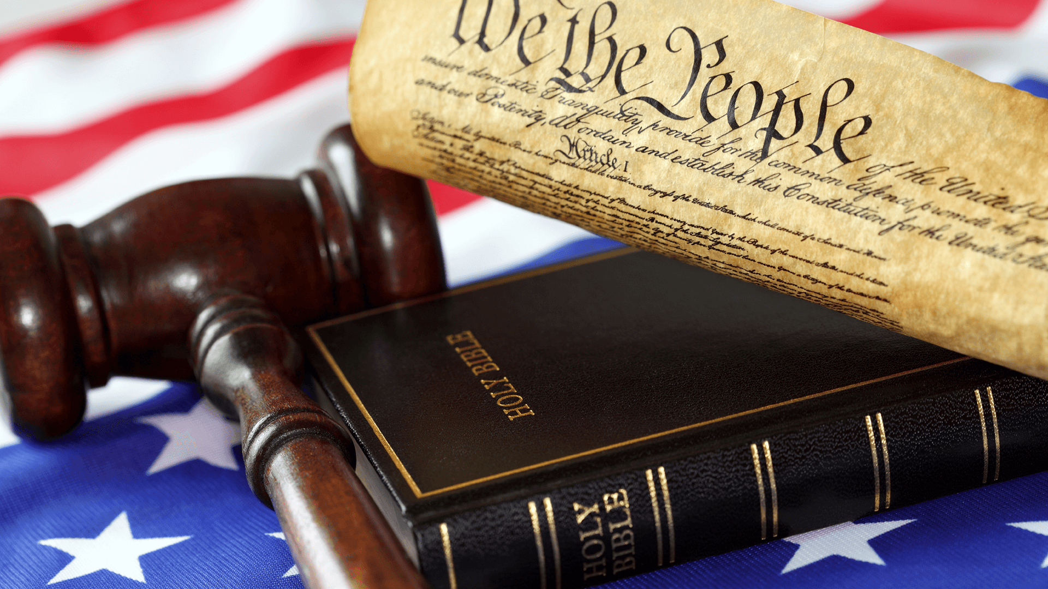


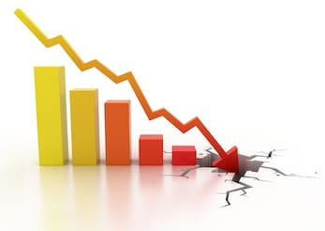
World Situation
  Is there sufficient Distress of Nations to fulfill Christ’s prophesy?
  Political Unrest
    Riots
    Mobs
    Offended for a word
  Religious Liberty Under Attack
  Economic Insecurity
  Covid Disruptions
  International Unrest
  War

Slide 61
Signs Summary
2017/5777
2000
2002
2004
2006
2008
2010
2012
2014
2016
2018
2020
2022
2024
2026
2028
2030
2032
1967 Generation of “Time of Gentiles Fulfilled” (70 years per generation-Psalms 90:10)
Gospels
Wickedness and Broken Covenants 2017 (5777) Significance:
100 years from Balfour (1917 - Jubilee), 70 years from UN (1947), 50 years from Jerusalem return (1967 – Jubilee)
9/11/01
Attack – Isaiah 9:10
Eclipse
(Sign of Jonah)
7
Years
Eclipse
(Sign of the Times)
Sun
3.5
3.5
Signs in Heavens
Blood Moons
Moon
Sign of Woman
Stars
Star of Bethlehem?
Woman (Church) Protected for 1260 days (3.5 years to March 5, 2021)
Distress of Nations
Political, International, Religious, Economic Distress

Slide 62
Natural Disasters
Earthquakes
Isaiah 13:13, Joel 2:10, 3:16, Matt 24:29, 24:7, Mark 13:8,Luke 21:11, Rev. 6:12-14, 8:5, 11:13 & 19, 16:18, 2 Nephi 23:13, 27:2, D&C 87:6
Hail/Fire
Isaiah 66:15-16, Rev. 8:7, D&C 29:16, 45:41
Famine, Plague, Pestilence
Matt 24:7, Mark 13:8, Luke 21:11, D&C 87:6
Sea, Thunder, Lightning
Luke 21:25, Rev 8:8-9, Rev. 8:5, 2 Nephi 27:2, D&C 87:6

Slide 63
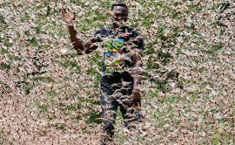
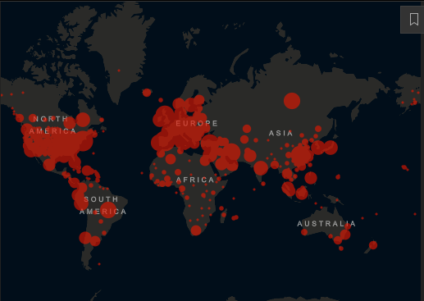
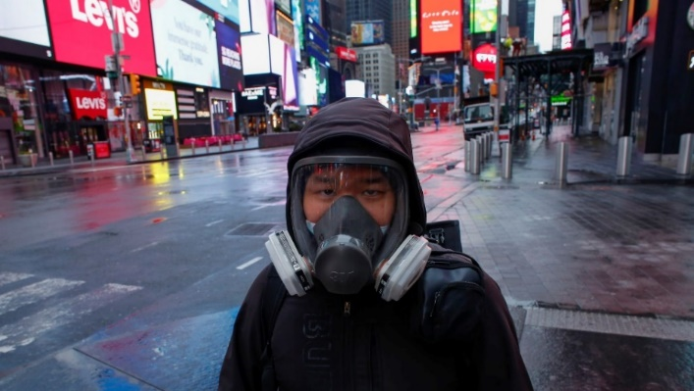
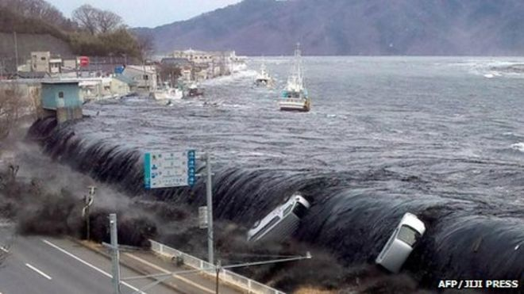
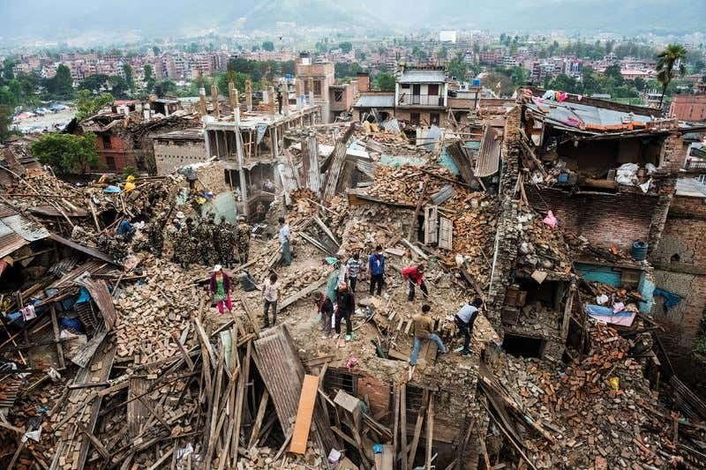
2020 Disasters
Pandemic/Plague: Coronavirus 42.8 M cases, 1.15 M deaths
Weather: Hurricane Zeta now approaching Gulf, ties record for named
Locusts: Swarms continue in Ethiopia and Somalia
Civil Unrest: Riots continue (Election spike?)
Fires: California, Colorado
Drought: Continuing worldwide
Famine: “Historical levels”, “biblical proportions”expected
Earthquakes/Volcanoes: M 7.6 in Alaska (Oct 19)

Slide 64
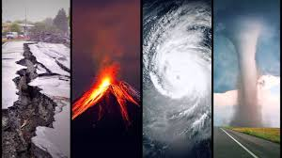
Natural Disasters
Are there sufficient natural disasters to fulfill the prophesy?
  “…and there shall be famines, and pestilences, and earthquakes, in divers places. All these are the beginning of sorrows.” (Matt 24:7-8)
  Word for sorrows in Greek means birth pains—periodic pain, increasing in frequency as delivery approaches. From when the “times of the Gentiles fulfilled”?

Slide 65
Signs Summary
2017/5777
2000
2002
2004
2006
2008
2010
2012
2014
2016
2018
2020
2022
2024
2026
2028
2030
2032
1967 Generation of “Time of Gentiles Fulfilled” (70 years per generation-Psalms 90:10)
Gospels
Wickedness and Broken Covenants 2017 (5777) Significance:
100 years from Balfour (1917 - Jubilee), 70 years from UN (1947), 50 years from Jerusalem return (1967 – Jubilee)
9/11/01
Attack – Isaiah 9:10
Eclipse
(Sign of Jonah)
7
Years
Eclipse
(Sign of the Times)
Sun
3.5
3.5
Blood Moons
Beginning
of Sorrows?
Signs in Heavens
Moon
Sign of Woman
Stars
Star of Bethlehem?
Woman (Church) Protected for 1260 days (3.5 years to March 5, 2021)
Distress of Nations
Political, International, Religious, Economic Distress
Hurricanes, Plague, Locust, Earthquakes, Fires, Famine
Natural Disasters

Slide 66
Fear, Heaven’s Power Shaken
Fear
Luke 21:26, Rev 6:15-17
Elect Deceived
Matt. 24:24
Church Tried

Slide 67
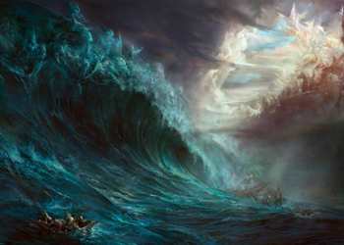
Heaven’s Power Shaken: Apostasy
How would heaven’s power be shaken? Is it now?

Slide 68





Fear and Heaven’s Power
Are the heaven’s power being shaken?
  Fear rampant
  Temples mostly closed, Churches were closed
  Missionaries mostly local
  Belief in God and Christ dwindling, persecution

Slide 69
Signs Summary
2017/5777
2000
2002
2004
2006
2008
2010
2012
2014
2016
2018
2020
2022
2024
2026
2028
2030
2032
1967 Generation of “Time of Gentiles Fulfilled” (70 years per generation-Psalms 90:10)
Gospels
Wickedness and Broken Covenants 2017 (5777) Significance:
100 years from Balfour (1917 - Jubilee), 70 years from UN (1947), 50 years from Jerusalem return (1967 – Jubilee)
9/11/01
Attack – Isaiah 9:10
Eclipse
(Sign of Jonah)
7
Years
Eclipse
(Sign of the Times)
Sun
3.5
3.5
Blood Moons
Beginning
of Sorrows?
Signs in Heavens
Moon
Sign of Woman
Stars
Star of Bethlehem?
Distress of Nations
Woman (Church) Protected for 1260 days (3.5 years to March 5, 2021)
Political, International, Religious, Economic Distress
Natural Disasters
Hurricanes, Plague, Locust, Earthquakes, Fires, Famine
Fear, Heaven’s Shaken
Temples closed, missionaries home, fear rampant, religious decline

Slide 70
Future Timing Scenarios
Revelation Timing
Daniel Timing

Slide 71

Timing Clues in the Scriptures
Generation of the return
Half hour of silence (20.8 years or 30 minutes)
  Represents warning that the bridegroom is coming (10 virgins)
3.5 years (Times, Time and a half; 42 months; 1260 days)
7 years (?)
70 years

Slide 72

Scripture Periods: ½ Hour
Rev.8 Open 7th seal, silence for ½ hour (20.8 years)
  Then: Voices, thunderings, lightnings, and an earthquake
  First Angel: Hail and fire mingled with blood
  Second Angel: Mountain of fire in the sea (undersea volcano?)
  Third Angel: A great star falls from heaven
  (asteroid/nuclear attack?)
  Fourth Angel: Sun, moon and stars darkened
  Fifth Angel: War
  Sixth Angel: War
  Seventh Angel: The Coming

Slide 73

Has the Seventh Seal Opened?
Sixth seal: Rev. 6-7
  Great earthquake; and the sun became black
  as sackcloth of hair, and the moon became
  as blood, heaven as scroll, mountain and
  island moved, people hide
    1202 Syria earthquake included Jerusalem
    and reportedly killed 1.1 million people.
    Caused a tsunami and failure of the Nile,
    resulting in famine and epidemics.
    Description seems to refer to later events:
    Isaiah 34:4, Rev. 16 (associated with 7th
    angel and Armageddon, after ½ hour), D&C 88

Slide 74

Sixth Seal Preparation for Seventh
Sixth seal: Rev. 6-7
  “Hurt not the earth, neither the sea, nor the trees, (events that will happen in the 7th seal) till we have sealed the servants of our God in
  their foreheads.” Seal 144,000, 12,000 from each tribe, virgins (Rev 14:4), high priests
    Where do you find so many from each tribe? Lost ten tribes? Sealed to do what?
  Multitude before the throne, white robes, palms, angels. Came out of tribulation, washed their robes. Before the throne of God and serve in God’s temple, God dwells among them.
    Sounds like events in heaven to prepare for second coming.
    City of Enoch preparations? (Some think it is fulfilled by the
    Palmyra Temple Dedication)

Slide 75

Church Position on Seventh Seal
Seventh Seal Opening
  D&C 77:7 “…the first seal contains the things of the first thousand years, and the second also of the second thousand years, and so on until the seventh.”
  Church website: Book of Revelation Overview (Seals)
    “5. (Rev. 6:9-11—about AD 1 to AD 1000)
    John sees the martyrs for Christ of the early Christian era.
    6. (About AD 1000 to AD 2000)
    Great Earthquake (Rev. 6:12-17)
    7. (About AD 2000 to AD 3000)
    Six Judgments (Rev.8 and Rev.9)”
If still in the 6th seal, we still have the 20.8 years of silence when 7th opens

Slide 76

The Seventh Seal Opened
April Conference 2020 like none other:
  Celebrating the 200th anniversary of the first vision
  No audience in the Conference Center, temple in China and Dubai
  Proclamation to the world of the restoration of the fulness of the gospel
  Those prepared by prophets for a “Home Centered Church” will watch from their homes in the midst of a global pandemic
April 6, 2000 Palmyra, NY Temple Dedication
  77th Dedicated temple, 100th announced temple
  Exactly 170 years from the church organization
  First temple dedication to be broadcast via satellite to every tongue and people
  Over 1,300 sites, dressed in white, waved white handkerchiefs representing palm leaves, representing the phrase “God Save Us” Rev. 7:9-11
Then ½ hour of silence in heaven (20.8 years). Then tribulations.

Slide 77
Scripture Periods: ½ Hour
D&C 88
    Not many days hence (1833): earth tremble, sun hide, moon blood, stars cast down, wrath, earthquakes, thunderings, lightnings, tempests, waves, hearts fail, angel trumps, great sign in heaven seen by all people, great church bound, sound trump and all hear—shall be silence in heaven for ½ hour (20.8 years? Maybe 30 minutes)
    Then: Immediately heaven unfolded as scroll, face of Lord unveiled, saints caught up, then trumps (7 resurrections, report on 7 millenia, Satan bound for a thousand years.)
    Does not appear that this is the ½ hour of Revelation. Maybe parallelism between God’s time revelation and earth time revelation for two different events in the return.
    Makes a big difference on timelines.

Slide 78
Signs Summary
2017/5777
2000
2002
2004
2006
2008
2010
2012
2014
2016
2018
2020
2022
2024
2026
2028
2030
2032
1967 Generation of “Time of Gentiles Fulfilled” (70 years per generation-Psalms 90:10)
Gospels
Wickedness and Broken Covenants 2017 (5777) Significance:
100 years from Balfour (1917 - Jubilee), 70 years from UN (1947), 50 years from Jerusalem return (1967 – Jubilee)
9/11/01
Attack – Isaiah 9:10
Eclipse
(Sign of Jonah)
7
Years
Eclipse
(Sign of the Times)
Sun
3.5
3.5
Blood Moons
Beginning
of Sorrows?
Signs in Heavens
Moon
Sign of Woman
Stars
Star of Bethlehem?
Woman (Church) Protected for 1260 days (3.5 years to March 5, 2021)
Distress of Nations
Political, International, Religious, Economic Distress
Natural Disasters
Hurricanes, Plague, Locust, Earthquakes, Fires, Famine
Fear, Heaven’s Shaken
Temples closed, missionaries home, fear rampant, religious decline
7th Seal
Opens
D&C ½ hour of silence?
About half hour of silence in the Heavens before Tribulations (+/- 20.8 Years)
Storms, earthquake then 7 angels released
200 years from first vision, 400 from first settlement
Revelation

Slide 79

Scripture Periods: 3.5 Years
This time periods occur seven times in scripture:
Daniel 7:25, "time, times and a half".
Daniel 12:7, "time, times and a half".
Revelation 11:2, "42 months"
Revelation 11:3, "1260 days"
Revelation 12:6, "1260 days"
Revelation 12:14, "time, times and a half"
Revelation 13:5, "42 months“
Are these additive (24.5 yrs), are some the same event, simultaneous, overlapping? How do they relate to the “7 year tribulation”?

Slide 80
Scripture Periods: 3.5 Years
Seven 3.5 Year References |  | Start | Period
Church Protected | Rev. 12:6 | Sign of woman in the heavens, woman (church of God) fled into the wilderness | fed (safe, protected) for 1260 days
 | Rev. 12:14 | Woman (church of God) given wings to fly into the wilderness from the serpent. Not associated with the sign described? | nourished for a time, and times, and half a time
Anti-Christ Rule (World) | Rev. 13:5 | Power given to the beast speaking great things and blasphemies, to make war with the saints, over all kindreds, and tongues, and nations | for 42 months
 | Dan. 7:25 | King after 10 kings, speaking against God, wear out the saints, changes times and laws. | Saints given into his hands for time, times and dividing of time. Then destroyed. Kingdom given to the saints of the most High.
Jerusalem | Rev. 11:2 | Gentile tread the holy city under foot, then reference to two prophets | 42 months
 | Rev. 11:3 | Power unto my two witnesses, and they shall prophesy | for 1260 days in sackcloth
Temple Timeline | Dan. 12: 7, 11, 12 | Time of trouble as never before, dead awaken, wise and righteous shine-"How long shall it be to the end of these wonders?” From the time when he shall scatter the power of the holy people.(Daniel asked for an explanation) Explanation: from time that the daily sacrifice is taken and abomination set up Blessed is he that waiteth, and cometh… | Time, times and and half til "all these things shall be finished. 1290 days to the "end of these things", "at the end of the days." to 1335 days. (added or just another 45 days?)

Slide 81

Seven Days (Years)
Daniel 9
27 And he shall confirm the covenant with many for one week (1 week, 7 years—only reference to 7-year period of tribulation): and in the midst of the week he shall cause the sacrifice and the oblation to cease (after 3.5 years), and for the overspreading of abominations he shall make it desolate, even until the consummation, and that determined shall be poured upon the desolate.”

Slide 82
Signs Summary
2017/5777
2000
2002
2004
2006
2008
2010
2012
2014
2016
2018
2020
2022
2024
2026
2028
2030
2032
1967 Generation of “Time of Gentiles Fulfilled” (70 years per generation-Psalms 90:10)
Gospels
Wickedness and Broken Covenants 2017 (5777) Significance:
100 years from Balfour (1917 - Jubilee), 70 years from UN (1947), 50 years from Jerusalem return (1967 – Jubilee)
9/11/01
Attack – Isaiah 9:10
Eclipse
(Sign of Jonah)
7
Years
Eclipse
(Sign of the Times)
Sun
3.5
3.5
3.5
Beginning
of Sorrows?
Late
Tribulations?
Blood Moons
Beginning of Tribulations?
Signs in Heavens
Moon
Sign of Woman
Stars
Star of Bethlehem?
Church to wilderness second time 3.5 yrs?
Woman (Church) Protected for 1260 days (3.5 years to March 5, 2021)
Distress of Nations
Political, International, Religious, Economic Distress
7th Seal
Opens
Natural Disasters
Hurricanes, Plague, Locust, Earthquakes, Fires, Famine
Fear, Heaven’s Shaken
Temples closed, missionaries home, fear rampant, religious decline
D&C ½ hour of silence?
Storms, earthquake then 7 angels released
About half hour of silence in the Heavens before Tribulations (+/- 20.8 Years)
200 years from first vision, 400 from first settlement
War with the Saints, 42 mo
Revelation
Gentiles tread Jerusalem,
42 mo. Before Prophets
Jerusalem Prophets,
42 mo.
From daily sacrifice taken,
end of wonders, 1290 days
Blessed he that waiteth,
1335 days, plus?

Slide 83

Seventy Weeks
Daniel 9
24 “Seventy weeks (In Hebrew weeks is “sevens.” 490 days = years? Ezekiel 4:4-6, Numbers 14:33-34) are determined upon thy people and upon thy holy city, to finish the transgression, and to make an end of sins, and to make reconciliation for iniquity, and to bring in everlasting righteousness, and to set up the vision and prophecy, and to anoint the most Holy.”
25 “Know therefore and understand, that from the going forth of the commandment to restore and to build Jerusalem unto the Messiah the Prince shall be seven weeks, and threescore and two weeks: the street shall be built again, and the wall, even in troublous times.” (7 weeks and 62 weeks- 483 days-years? From commandment to rebuild Jerusalem to the Messiah.)
26 “And after threescore and two weeks shall Messiah be cut off, (434 years) but not for himself: and the people of the prince that shall come shall destroy the city and the sanctuary; and the end thereof shall be with a flood, and unto the end of the war desolations are determined.”
27 And he shall confirm the covenant with many for one week (1 week, 7 years—only reference to 7 year period of tribulation): and in the midst of the week he shall cause the sacrifice and the oblation to cease (after 3.5 years), and for the overspreading of abominations he shall make it desolate, even until the consummation, and that determined shall be poured upon the desolate.”

Slide 84

Seventy Weeks
Daniel lived from 620-538 BC to Babylon in 605 BC
Wikipedia: “Historicist interpretation of the Prophecy of Seventy Weeks was that it foretells with great specificity information about Jesus as the Messiah, not some low level official or antichrist figure. Daniel 9:25 states that the 'seventy weeks' (generally interpreted as 490 years according to the day-year principle) is to begin "from the time the word goes out to restore and rebuild Jerusalem," which is when the Persian king Artaxerxes, gave the decree to rebuild Jerusalem to Ezra, so the 490 years point to the time of Christ's anointing.
Does this timing also apply to His second coming?

Slide 85

Fast Track
Aaron Ellis: Potential Timeline of Signs and Events Leading Up to the Second Coming
https://www.youtube.com/watch?v=E8FNkaB_1Bs&t=459s

Slide 86

Masa Yoshi
Signs of the Second Coming of Christ, private website, Masa Yoshi
https://www.youtube.com/watch?v=Klg4aj7C5vk

Slide 87

America’s Future Timeline – Part IV - Isaiah
Ryan Allen
https://www.youtube.com/watch?v=EhPPGTojnxI&feature=youtu.be&fbclid=IwAR10w-NNGVW-TgEWQipsxk6_bB14-aeEQ3mpsXpKlv1BT8qzdWzzZtdMNbg

Slide 88

Another Timeline
Daniel’s first 1290 days
Revelation Trumpets 1-5
2020-2024
Daniel’s 2nd 1335 days
Revelation Trumpets 6-7
2024-2027
2020
End of Rev. ½ hr. silence (20.8 yrs.)
Daily sacrifice stopped
2021 In-country destruction
J. Smith prophecy: depreciation of $ triggers civil war
2022 Shemita: Callout, Plagues, invasion
2023 Ten Tribes, City of Enoch, New Jerusalem
Savior visits saints, Adam-ondi-Ahman (time?)
2024-2027
Anti-Christ (42 Months)
2 prophets in Jerusalem from New Jerusalem (1260 days)
Armageddon
Followed by ½ hr. of silence (30 min.)
Second Coming
Shelle McDermott

Slide 89
Signs Summary
2017/5777
2000
2002
2004
2006
2008
2010
2012
2014
2016
2018
2020
2022
2024
2026
2028
2030
2032
1967 Generation of “Time of Gentiles Fulfilled” (70 years per generation-Psalms 90:10)
Gospels
Wickedness and Broken Covenants 2017 (5777) Significance:
100 years from Balfour (1917 - Jubilee), 70 years from UN (1947), 50 years from Jerusalem return (1967 – Jubilee)
9/11/01
Attack – Isaiah 9:10
Eclipse
(Sign of Jonah)
7
Years
Eclipse
(Sign of the Times)
Sun
3.5
3.5
3.5
Beginning
of Sorrows?
Late
Tribulations?
Blood Moons
Beginning of Tribulations?
Signs in Heavens
Moon
Sign of Woman
Stars
Star of Bethlehem?
Church to wilderness second time 3.5 yrs?
Woman (Church) Protected for 1260 days (3.5 years to March 5, 2021)
Distress of Nations
Political, International, Religious, Economic Distress
7th Seal
Opens
Natural Disasters
Hurricanes, Plague, Locust, Earthquakes, Fires, Famine
Fear, Heaven’s Shaken
Temples closed, missionaries home, fear rampant, religious decline
D&C ½ hour of silence?
Storms, earthquake then 7 angels released
About half hour of silence in the Heavens before Tribulations (+/- 20.8 Years)
200 years from first vision, 400 from first settlement
Revelation
War with the Saints, 42 mo
Gentiles tread Jerusalem,
42 mo. Before Prophets
Jerusalem Prophets,
42 mo.
From daily sacrifice taken,
end of wonders, 1290 days
Blessed he that waiteth,
1335 days, plus?

Slide 90
Preparation
Mental, Emotional Preparation
Physical Preparation
Spiritual Preparation

Slide 91

Abrahamic Tests
“God has always asked His covenant children to do difficult things Because you are covenant-keeping sons and daughters of God, living in the latter part of these latter days, the Lord will ask you to do difficult things. You can count on it—Abrahamic tests did not stop with Abraham.
(Nelson, “Becoming True Millennials,” worldwide
devotional for young adults, January 2016)

Slide 92

No Warning (Correction)
  “With no warning, no last-minute preparation is possible…I believe that the Ten Virgins represent the people of the Church of Jesus Christ and not the rank and file of the world. All of the virgins, wise and foolish, had accepted the invitation to the wedding supper; they had knowledge of the program and had been warned of the important day to come. They were not the gentiles or the
  heathens or the pagans, nor were they
  necessarily corrupt and reprobate, but
  they were knowing people who were
  foolishly unprepared for the vital
  happenings that were to affect their
  eternal lives.”(President Spencer W.
  Kimball, Faith Precedes the Miracle, Ch. 23)

Slide 93

Hard to Wait
  “Time had passed, and he had not come. They had heard of his coming for so long, so many times, that the statement seemingly became meaningless to them. Would he ever come? So long had it been since they began expecting him that they were rationalizing that he would never appear. Perhaps it was a myth. Hundreds of thousands of us today are in this position. Confidence has been dulled and
  patience worn thin. It is so hard to wait
  and be prepared always. But we cannot
  allow ourselves to slumber. The Lord
  has given us this parable as a special
  warning.” (President Spencer W.
  Kimball, Faith Precedes the Miracle, Ch. 23)

Slide 94

Now is the Time
  “While we are powerless to alter the fact of the Second Coming and unable to know its exact time, we can accelerate our own preparation and try to influence the preparation of those around us. We are living in the prophesied time “when peace shall be taken from the earth, when “all things shall be in commotion” and “men’s hearts shall fail them.” (President Oaks, April 2004 General Conference)
  Has he changed his mind since 2004?

Slide 95

Prepare for Where?
Many saints will likely gather from their homes to “places of safety”, which we may consider in our preparations
  “The time is coming when those who do
  not obey the Lord will be separated from
  those who do.”
  Pres Nelson (The Future of the Church:
  Preparing the World for the Savior’s Second
  Coming, Ensign April 2020)

Slide 96

Gathering = Standard Procedure
Examples of the Lord’s people being gathered from among the wicked
  Enos, Enoch, Noah, Jaredites, Abraham (three times), Lot, Joseph, Moses, Lehi, Nephi, Mosiah, Mulek, Alma, Joseph Smith
  Find a very nice list at:
https://lookaside.fbsbx.com/file/Call%20Out%20Gathering%20Quotes.pdf?token=AWxB8RIfdq5v-dgCqZ4ec-ir0sGQj6tZ0UG5JyNHBwZRNwIwP9FDqw2Ob6tcRYs_-yRsGulyM5VeJJ-pXGwmAn0_kwdO-2EZOvBlbDDGCUxzgSGIiabnZ6KvxqdnHVIWvcBFdAoR2RLr58JlWJTgXwZnyAZTT9z8cbaZzfnSgHcZPtBLIZmqnQWAe3vP0sWBcs-tnMJh2zQshl0SMv7vvHtqeV-iULExjA5ncj0_WG_r2A

Slide 97

Exercise Faith
  “Meanwhile, here and now, we live in a time of turmoil. Earthquakes and tsunamis wreak devastation, governments collapse, economic stresses are severe the family is under attack, and divorce rates are rising. We have great cause for concern. But we do not need to let our fears displace our faith. We can combat those fears by strengthening our faith…Do whatever it takes to strengthen your faith in Jesus Christ by increasing your understanding of the doctrine taught in His restored
  Church and by relentlessly seeking truth. Anchored
  in pure doctrine, you will be able to step forward
  with faith and dogged persistence and cheerfully do
  all that lies in your power to fulfill the purposes of
  the Lord.” (Pres. Nelson, The Future of the Church:
  Preparing the World for the Savior’s Second Coming, April 2020 Ensign)

Slide 98

Remember Your Birthright
  “How you deal with life’s trials is part of the development of your faith. Strength comes when you remember that you have a divine nature, an inheritance of infinite worth. The Lord has reminded you, your children, and your grandchildren that you are lawful heirs, that you have been reserved in heaven for your specific time and place to be born, to grow and become His standard bearers and covenant people. As you walk in the Lord’s path of righteousness, you will be blessed to continue
  in His goodness and be a light and a savior unto
  His people (see D&C 86:8-11) .”
  (Pres. Nelson, April 2020 Ensign)

Slide 99

Keep Your Covenants
  Keep your Covenants and the Commandments
    Priesthood, Sabbath, Temple, Tithing
  “I promise you that as you follow Jesus Christ, you will find sustained peace and true joy. As you keep your covenants with increasing precision, and as you defend the church and kingdom of God on the earth today, the Lord will bless you with strength and wisdom to accomplish what only
  members of the church of Jesus Christ of
  Latter-day Saints can accomplish.”
  (Pres Nelson, April 2020 Ensign)

Slide 100

Follow the Prophet
  Bruce R. McConkie: “In every age the Lord gives his people the direction they need at the moment of their peril and danger. And surely in the days ahead there will be times when nothing but the wisdom of God, descending from heaven and flowing from prophetic lips will be able to save his people.” A New Witness for the Articles of Faith (Deseret Book Company, 1985), 478
  Is every recent change in the church designed to help us prepare?
    Gather Israel
    Home centered church
    Priesthood quorums combined
    Temple changes
    Ministering

Slide 101



Be of Good Cheer
    “Therefore, dearly beloved brethren, let us cheerfully do all things that lie in our power; and then may we stand still, with the utmost assurance, to see the salvation of God, and for his arm to be revealed.” D&C 123:17

Slide 102

The Lord Will Prevail
“We know for certain that if and when everything else in the latter days is down or dying; if governments, economies, industries, and institutions crumble; if societies and cultures become a quagmire of chaos and insecurity, nevertheless, through it all the gospel of Jesus Christ and The Church of Jesus Christ of Latter-day Saints that bears that gospel to the world will stand triumphant. It will stand undefiled in God’s hand until the very Son of God Himself comes to rule and reign as Lord of lords and King of Kings. Nothing is more certain in this world. Nothing is more sure.”
Jeffrey R. Holland, Church Education System Broadcast, Feb. 6, 2015

Slide 103

Finally…
Are you watching?
Do you see the signs?
Is there oil in your lamp?

Slide 104
Signs Summary
2017/5777
2000
2002
2004
2006
2008
2010
2012
2014
2016
2018
2020
2022
2024
2026
2028
2030
2032
1967 Generation of “Time of Gentiles Fulfilled” (70 years per generation-Psalms 90:10)
Gospels
Wickedness and Broken Covenants 2017 (5777) Significance:
100 years from Balfour (1917 - Jubilee), 70 years from UN (1947), 50 years from Jerusalem return (1967 – Jubilee)
9/11/01
Attack – Isaiah 9:10
Eclipse
(Sign of Jonah)
7
Years
Eclipse
(Sign of the Times)
Sun
3.5
3.5
3.5
Beginning
of Sorrows?
Late
Tribulations?
Blood Moons
Beginning of Tribulations?
Signs in Heavens
Moon
Sign of Woman
Stars
Star of Bethlehem?
Church to wilderness second time 3.5 yrs?
Woman (Church) Protected for 1260 days (3.5 years to March 5, 2021)
Distress of Nations
Political, International, Religious, Economic Distress
7th Seal
Opens
Natural Disasters
Hurricanes, Plague, Locust, Earthquakes, Fires, Famine
Fear, Heaven’s Shaken
Temples closed, missionaries home, fear rampant, religious decline
D&C ½ hour of silence?
Storms, earthquake then 7 angels released
About half hour of silence in the Heavens before Tribulations (+/- 20.8 Years)
200 years from first vision, 400 from first settlement
Revelation
War with the Saints, 42 mo
Gentiles tread Jerusalem,
42 mo. Before Prophets
Jerusalem Prophets,
42 mo.
From daily sacrifice taken,
end of wonders, 1290 days
Blessed he that waiteth,
1335 days, plus?

Slide 105
Jubilee Summary
40th
Jubilee
50th
Jubilee
60th
Jubilee
70th
Jubilee
80th
Jubilee
120th
Jubilee
Creation
2000 years
500
years
500
years
500
years
500
years
Israel
2000 years
Abraham
Born
Temple Complete
Christ’s 1st Coming
Christ’s
Reign
Begins
The Exodus
Decree to Restore
Jerusalem
6000 years
Genesis 6:3

